Slide 1
SystemVerilog for Synthesis and Verification

Slide 2
VLSI Design Flow
Design Specifications
Design Entry (Schematic/HDL)
Functional Verification & Power Analysis
Logic & Test Synthesis
Technology
Library
Static
Timing
Analysis
Gate
Level
Simulation
Formal
Verification
Power
Estimation
Floor Planning & CTS
Layout Design
Placement & Routing
Front End
SDF &
Parasitics
Physical Verification (DRC & LVS)
Back End
Verification Signoff
Tapeout

Slide 3
Design Synthesis and Verification
Input for Verification engineers
Good Specifications of the RTL
Deliverables by verification engineers:
A good verification plan
Details of testcase and test environment
Scheduled Review with RTL Designer

Slide 4
DUT and Testbench
Specification of an ALU
OP CODE | FUNCTIONALITY
0 | Addition
1 | Subtraction
2 | Multiplication
3 | Division
4 | Modulo Division
5 | Logical AND
6 | Logical OR
7 | Logical Negation
8 | Bitwise Negation
9 | Bitwise AND
10 | Bitwise OR
11 | Bitwise XOR
12 | Left Shift
13 | Right Shift
14 | Increment
15 | Decrement
I/O:
4 bit OPCODE
8 bit OPERANDS
16 bit OUTPUT

Slide 5
ALU Test Bench
module testbench;
reg clk;
reg [7:0] a,b;
reg [3:0] s;
wire [15:0] out;
initial begin
clk = 1'b0;
a = $random;
b = $random;
s = 4'bx;
#30
s = 0;
#10
result_checker(s,a,b,out);
#10
s = 14;
#10
result_checker(s,a,b,out);
#10
s = $random;
#10
result_checker(s,a,b,out);
$finish;
end
task result_checker(input [3:0] s,input [7:0] a,b,input [15:0]resulted_out);
reg [15:0] expected_out;
begin
if(s==0) expected_out=a + b;
else if(s==1) expected_out=a - b;
else if(s==2) expected_out=a * b;
else if(s==3) expected_out=a / b;
else if(s==4) expected_out=a % b;
else if(s==5) expected_out=a && b;
else if(s==6) expected_out=a || b;
else if(s==7) expected_out=!a;
else if(s==8) expected_out=~a;
else if(s==9) expected_out=a & b;
else if(s==10) expected_out=a | b;
else if(s==11) expected_out=a ^ b;
else if(s==12) expected_out=a << 1;
else if(s==13) expected_out=a >> 1;
else if(s==14) expected_out=a + 1;
else if(s==15) expected_out=a - 1;
if(resulted_out == expected_out)
$display("Passed : a=%d, b=%d, s=%d, resulted_out=%d, expected_out=%d", a,b,s,resulted_out,expected_out);
else
$display("Failed : a=%d, b=%d, s=%d, resulted_out=%d, expected_out=%d", a,b,s,resulted_out,expected_out);
end
endtask
initial
forever #5 clk = ~clk;
alu DUT( .clk (clk),
.a (a),
.b (b),
.s (s),
.out (out)
);

Slide 6
Distinction Between V and SV
SystemVerilog(SV) is both a HDL and HVL
(Hardware Verification Language),so combined termed as HDVL.
SV is enriched with wide variety of data type like int, shortint, longint, logic, bit, real, realtime, reg, user defined data type etc. which are both combination of 4 and 2 valued logic.
SV uses always_ff, always_comb, always_latch construct for use of different logic.
SV uses interface construct which is used for bunching of all the signals along with clocking block which is used for synchronization unlike Verilog in which instantiation with the DUT becomes tedious because of large number of signals.
SV uses Class based testbench which is dynamic in nature.
Features like Functional Coverage, SV assertions and constraint random verification can only be possible with SV which helps in debugging purpose and to discover uncover bugs
Verilog is a HDL(Hardware Description Language).
Verilog has mainly 2 data types Reg and Wire which are 4 valued logic 0,1,X,Z.
Verilog has a single always block for implementation of combinational and sequential logic.
Verilog does not have interface construct.
Verilog uses module level testbench.
Verilog does not have Coverage and Assertion features.

Slide 7
Outline
SystemVerilog
module adder(input logic [31:0] a,
input logic [31:0] b,
output logic [31:0] y);
assign y = a + b;
Endmodule
A block of hardware with inputs and outputs is called a module.
Note that the inputs and outputs are 32-bit busses.
True power of HDL comes from higer level of abstraction

Slide 8
Data type Logic
SV improves the classic reg data type so that it can be driven by continuous assignments, gates, and modules, in addition to being a variable. It is given the synonym logic so that it does not look like a register declaration.
A logic signal can be used anywhere a net is used, except that a logic variable cannot be driven by multiple structural drivers, such as when you are modeling a bidirectional bus. In this case, the variable needs to be a net-type such as wire so that SV can resolve the multiple values to determine the final value.
logic q, q1, d, clk, rst_n;
logic [3:0] result;

Slide 9
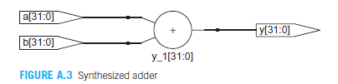
Simulaion and Synthesis
Two major function of HDL are Logic Simulation and Synthesis
During simulation inputs are applied to a module and the outputs are checked to verify that the module works correctly.
During synthesis the textual description of a module is transformed into logic gates.
;

Slide 10

Combinational Logic (CL)
The output of combinational logic depends only on current inputs. CL has no memory.
Behavioral model of Combinational Logic
2.1 Bitwise Operators
Bitwise operators act on single-bit signals or on multibit busses. For example, the inv module in Example A.3 describes four inverters connected to 4-bit busses.
module inv( input logic [3:0] a,
output logic [3:0] y);
assign y = ~a;
endmodule

Slide 11
Logic Gates
module gates( input logic [3:0] a, b,
output logic [3:0] y1, y2,y3, y4, y5);
/* Five different two-input logic gates acting on 4 bit busses */
assign y1 = a & b; // AND
assign y2 = a | b; // OR
assign y3 = a ^ b; // XOR
assign y4 = ~(a & b); // NAND
assign y5 = ~(a | b); // NOR
endmodule
~, ^, and | are examples of SystemVerilog operators, while a, b, and y1 are operands. A combination of operators and operands, such as a & b, or ~(a | b) are called expressions. A complete command such as assign y4 = ~(a & b); is called a statement.

Slide 12
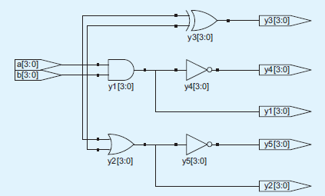
Logic Gates
assign out = in1 op in2; is called a continuous assignment statement. Continuous assignment statements end with a semicolon. Any time the inputs on the right side of the = in a continuous assignment statement change, the output on the left side is re-computed. Thus, continuous assignment statements describe combinational logic.

Slide 13
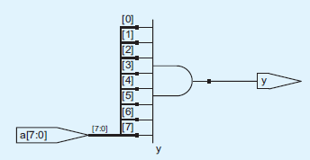
3 Reduction Operators
Reduction operators imply a multiple-input gate acting on a single bus. For example, example below describes an 8-input AND gate with inputs a0, a1, ..., a7.
module and8( input logic [7:0] a,
output logic y);
assign y = &a;
// &a is much easier to write than
// assign y = a[7] & a[6] & a[5] & a[4] &
// a[3] & a[2] & a[1] & a[0];
endmodule
As one would expect, |, ^, ~&, and ~| reduction operators are available for OR, XOR, NAND, and NOR as well. Recall that a multi-input XOR performs parity, returning TRUE if an odd number of inputs are TRUE.

Slide 14
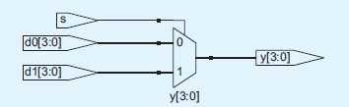
4. Conditional Operators
The conditional operator ?: chooses, based on a first expression, between a second and third expression. The first expression is called the condition. If the condition is 1, the operator chooses the second expression. If the condition is 0, the operator chooses the third expression.
module mux2( input logic [3:0] d0, d1,
input logic s,
output logic [3:0] y);
assign y = s ? d1 : d0;
endmodule
If s = 1, then y = d₁. If s = 0, then y = d₀ .
?: is also called a ternary operator because it takes three inputs. It is used for the same purpose in the C and Java programming languages.

Slide 15
Conditional Operators
A 4:1 multiplexer can select one of four inputs using nested conditional
operators.
module mux4( input logic [3:0] d0, d1, d2, d3,
input logic [1:0] s,
output logic [3:0] y);
assign y = s[1] ? (s[0] ? d3 : d2)
: (s[0] ? d1 : d0);
endmodule
If s[1] = 1, then the multiplexer chooses the first expression, (s[0] ? d3 : d2). This expression in turn chooses either d3 or d2 based on s[0] (y = d3 if s[0] = 1 and d2 if s[0] = 0). If s[1] = 0, then the multiplexer similarly chooses the second expression, which gives either d1 or d0 based on s[0].

Slide 16
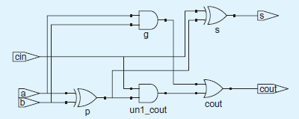
Internal Variables
Often, it is convenient to break a complex function into intermediate steps. For example, we sometime define the propagate signal as the XOR of the two inputs A and B. The sum from the adder is the XOR of the propagate signal and the carry-in. We can declare the propagate signal using a wire statement in much the same way we use local variables in a programming language.
module fulladder( input logic a, b, cin,
output logic s, cout);
logic p, g;
assign p = a ^ b;
assign g = a & b;
assign s = p ^ cin;
assign cout = g | (p & cin);
endmodule

Slide 17
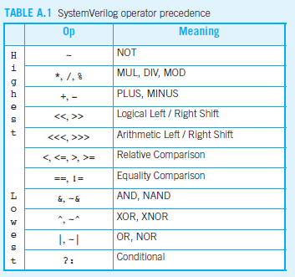
Operator Precedence
The operator precedence for SystemVerilog is much like we would
expect in other programming languages. In particular, as shown in
Table A.1, AND has precedence over OR etc.

Slide 18
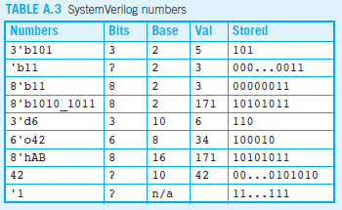
SystemVerilog Numbers
As shown in Table A.3, SystemVerilog numbers can specify their base and size (the number of bits used to represent them). The format for declaring constants is N'Bvalue, where N is the size in bits, B is the base, and value gives the value. For example 9'h25 indicates a 9-bit number with a value of 2516 = 3710 = 0001001012. SystemVerilog supports 'b for binary (base 2), 'o for octal (base 8), 'd for decimal (base 10), and 'h for hexadecimal (base 16). If the base is omitted, the base defaults to decimal.

Slide 19
Zs and Xs
HDL use z to indicate a floating value. z is particularly useful for describing a tristate buffer, whose output floats when the enable is 0. A bus can be driven by several tristate buffers, exactly one of which should be enabled.
module tristate( input logic [3:0] a,
input logic en
output tri [3:0] y);
assign y = en ? A : 4’bz;
endmodule
Notice that y is declared as tri rather than logic. logic signals can only have a single driver
Tristate busses can have multiple drivers, so they should be declared as net.
There are 2 types of net in System Verilog : tri and trireg
If no driver is active, a tri floats (z) while a trireg retains the previous value.

Slide 20
Bit Swizzling
Often it is necessary to operate on a subset of a bus or to concatenate i.e., join together , signals to form busses. These operations are collectively known as bit swizzling.
In example below y is given the 9-bit value c2c1d0d0d0c0101 using bit swizzling operation
assign y = {c[2:1], {3{d[0]}}, c[0], 3’b101};
The {} operate is used to concatenate busses.
Note that it was critical to specify the length of 3 bits in the cosntant
Example below shows how to split an output into 2 pieces using bit swizzling
module mul ( input logic [7:0] a,b,
output logic [7:0] upper, lower);
assign {upper, lower} = a*b;
endmodule

Slide 21
Delays
HDL statements may be associated with delays specified in arbitrary units. They are helpful during simulation to predict how fast a circuit will work (if you specify meaningful delays) and also for debugging purposes to understand cause and effect (deducing the source of a bad output is tricky if all signals change simultaneously in the simulation results). These delays are ignored during synthesis; the delay of a gate produced by the synthesizer depends on its tpd and tcd specifications, not on numbers in HDL code.
timescale 1ns/1ps
module example( input logic a, b, c, output logic y);
logic ab, bb, cb, n1, n2, n3;
assign #1 {ab, bb, cb} = ~{a, b, c};
assign #2 n1 = ab & bb & cb;
assign #2 n2 = a & bb & cb;
assign #2 n3 = a & bb & c;
assign #4 y = n1 | n2 | n3;
endmodule

Slide 22
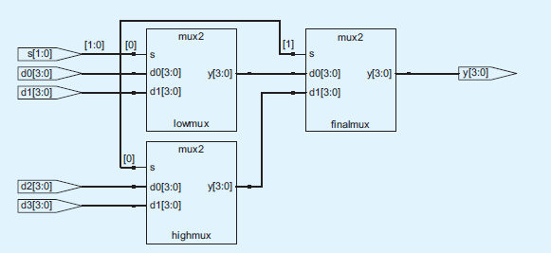
Structural Modeling
This section examines structural modeling,
Example below shows how to assemble a 4:1 multiplexer from three 2:1 multiplexers. Each copy of the 2:1 multiplexer is called an instance. Multiple instances of the same module are distinguished by distinct names. This is an example of regularity, in which the 2:1 multiplexer is reused three times.
module mux4( input logic [3:0] d0, d1, d2, d3,
input logic [1:0] s,
output logic [3:0] y);
logic [3:0] low, high;
mux2 lowmux(d0, d1, s[0], low);
mux2 highmux(d2, d3, s[0], high);
mux2 finalmux(low, high, s[1], y);
endmodule
The three mux2 instances are called lowmux, highmux, and finalmux. The mux2 module must be defined elsewhere in the SystemVerilog code.

Slide 23

Sequential Logic
Assign statements are reevaluated every time any term on the right side changes. Therefore, they might describe combinational logic. Always block are reevaluated only when signals in the sensitivity list changes. Depending on the form, always block can imply either sequential or combinational circuits.
Registers
module flop ( input logic clk,
input logic [3:0] d,
output logic [3:0] q);
always_ff @(posedge clk)
q <= d;
endmodule
As will be seen in subsequent sections, always statements can be used to imply flip-flops, latches, or combinational logic, depending on the sensitivity list and statement. Because of this flexibility, it is easy to produce the wrong hardware inadvertently. SystemVerilog introduces always_ff, always_latch, and always_comb to reduce the risk of common errors. always_ff behaves like always, but is used exclusively to imply flip-flops and allows tools to produce a warning if anything else is implied.

Slide 24
Sequential Logic
A Verilog always statement is written in the form always @(sensitivity list)
statement;
The statement is executed only when the event specified in the sensitivity
list occurs. In this example, the statement is q <= d (pronounced “q gets d”). Hence, the flip-flop copies d to q on the positive edge of the clock and otherwise remembers the old state of q.
<= is called a nonblocking assignment. Note that <= is used instead of assign inside an always statement.

Slide 25

Sequential Logic
SystemVerilog : Synchronous reset
Synchronous reset takes fewer transistors and reduces the risk of timing problems on the trailing edge of reset. However, if clock gating is used, care must be taken that all flipflops reset properly at startup.
module flopr( input logic clk,
input logic reset,
input logic [3:0] d,
output logic [3:0] q);
// synchronous reset
always_ff @(posedge clk)
if (reset) q <= 4'b0;
else q <= d;
endmodule

Slide 26
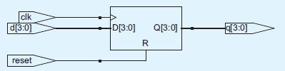
Sequential Logic
SystemVerilog : asynchornous reset
Asynchronous reset occurs immediately, hence reset signal is included in the sensitivity list. Thus, the asynchronously resettable flop immediately responds to a rising edge on reset, but the synchronously resettable flop only responds to reset on the rising edge of the clock.
module flopr( input logic clk,
input logic reset,
input logic [3:0] d,
output logic [3:0] q);
// asynchronous reset
always_ff @(posedge clk, posedge reset)
if (reset) q <= 4'b0;
else q <= d;
endmodule

Slide 27
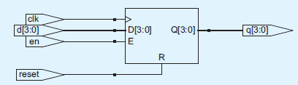
Sequential Logic
SystemVerilog : Resettable Enabled Register
Asynchronous reset occurs immediately, hence reset signal is included in the sensitivity list. Thus, the asynchronously resettable flop immediately responds to a rising edge on reset, but the synchronously resettable flop only responds to reset on the rising edge of the clock.
module flopenr( input logic clk, input logic reset,
input logic en,
input logic [3:0] d,
output logic [3:0] q);
// synchronous reset
always_ff @(posedge clk)
if (reset) q <= 4'b0;
else if (en) q <= d;
endmodule

Slide 28
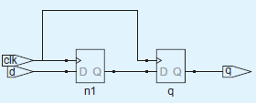

Sequential Logic
SystemVerilog : Multiple Register
A single always / process statement can be used to describe multiple pieces of hardware. For example, consider describing a synchronizer made of two back-to-back flipflops, as shown in Figure A.20. Example A.23 describes the synchronizer. On the rising edge of clk, d is copied to n1. At the same time, n1 is copied to q.
module sync( input logic clk, input logic d,
output logic q);
logic n1;
always_ff @(posedge clk)
begin
n1 <= d;
q <= n1;
end
endmodule

Slide 29
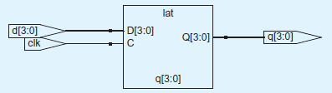
Sequential Logic
SystemVerilog : Latches
Recall that a D latch is transparent when the clock is HIGH, allowing data to flow from input to output. The latch becomes opaque when the clock is LOW, retaining its old state. Example below shows the idiom for a D latch.
module latch( input logic clk,
input logic [3:0] d,
output logic [3:0] q);
always_latch
if (clk) q <= d;
endmodule
always_latch is equivalent to always @(clk, d) and is the preferred way of describing a latch in SystemVerilog. It evaluates any time clk or d changes. If clk is HIGH, d flows through to q, so this code describes a positive level sensitive latch. Otherwise, q keeps its old value. SystemVerilog can generate a warning if the always_latch block doesn’t imply a latch.

Slide 30
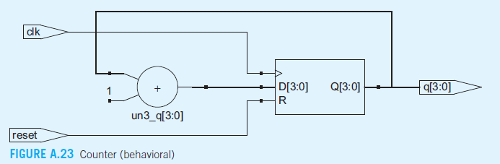
Sequential Logic
Behavioral code of a counter
module counter (input logic clk,
input logic reset,
output logic [3:0] q);
always_ff @ (posedge clock)
if (reset) q <= 4’b0;
else q <= q+1;
endmodule
Behavioral code of shift register with parallel load
module shiftreg (input logic clk,
input logic reset, load,
input logic sin,
input logic [3:0] d,
input logic [3:0] q,
output logic sout);
always_ff @ (posedge clock)
if (reset) q <= 0;
else if (load) q <= d;
else q <= {q[2:0], sin};
assign sout = q[3]:
endmodule

Slide 31
Blocking & Non-blocking
Always statements can also be used to describe combinational logic behaviorally if the sensitivity list is written to respond to changes in all of the inputs and the body prescribes the output value for every possible input combination.
module inv( input logic [3:0] a, output logic [3:0] y);
always_comb
y = ~a;
endmodule
always_comb is equivalent to always @(*) and is the preferred way of describing combinational logic in SystemVerilog. always_comb reevaluates the statements inside the always statement any time any of the signals on the right-hand side of <= or = inside the always statement change. Thus, always_comb is a safe way to model combinational logic.
The = in the always statement is called a blocking assignment, in contrast to the <= nonblocking assignment. In SystemVerilog, it is good practice to use blocking assignments for combinational logic and nonblocking assignments for sequential logic.
Inside always, A group of blocking assignment are evaluated in the order thy appear in the code while nonblocking assignements are evaluated concurrently;

Slide 32
Case and if statement
These two examples are poor applications of always process statements for modeling combinational logic because they require more lines than the equivalent
approach with assign statements. Moreover, they pose the risk of inadvertently implying sequential logic if the sensitivity list leaves out inputs.
However, case and if statements are convenient for modelling more complicated combinational logic. case and if statements can only appear within always statement.

Slide 33
Case statement
module sevenseg(input logic [3:0] data,
output logic [6:0] segments);
always_comb
case (data)
// abc_defg
0: segments = 7'b111_1110;
1: segments = 7'b011_0000;
2: segments = 7'b110_1101;
3: segments = 7'b111_1001;
4: segments = 7'b011_0011;
5: segments = 7'b101_1011;
6: segments = 7'b101_1111;
7: segments = 7'b111_0000;
8: segments = 7'b111_1111;
9: segments = 7'b111_1011;
default: segments = 7'b000_0000;
endcase
endmodule
In SystemVerilog case statements must appear inside always statements.

Slide 34
if statement
always / process statements can also contain if statements. The if may be followed by an else statement. When all possible input combinations are handled, the statement implies combinational logic; otherwise it produces sequential logic (like the latch in Section
module priorityckt( input logic [3:0] a,
output logic [3:0] y);
always_comb
if (a[3]) y = 4'b1000;
else if (a[2]) y = 4'b0100;
else if (a[1]) y = 4'b0010;
else if (a[0]) y = 4'b0001;
else y = 4'b0000;
endmodule

Slide 35
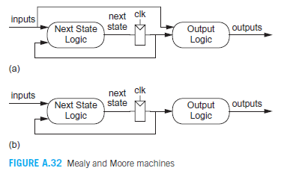
Finite State Machine
There are two styles of finite state machines. In Mealy machines (Figure A.32(a)), , the output is a function of the current state and inputs. In Moore machines (Figure A.32(b)), the output is a function of the current state only. In both types, the FSM can be partitioned into a state register, next state logic, and output logic. HDL descriptions of state machines are correspondingly divided into these same three parts.

Slide 36
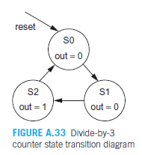
FSM: Divide by 3 counter
The simple finite state machine considered here is a divide-by-3 counter which has one output and one input. The output should be asserted every three clock cycles. The state transition diagram for a Moore machine is shown in figure below. The output value is labeled in each state because the output is only a function of the state.
Present State | Next State |  | Output y
 | posedge=0 | Posedge=1
S0 | S0 | S1 | 1
S1 | S1 | S2 | 0
S2 | S2 | S0 | 0
Present State | Next State |  | Output y
 | posedge=0 | Posedge=1
00 | 00 | 01 | 1
01 | 01 | 10 | 0
10 | 10 | 00 | 0

Slide 37
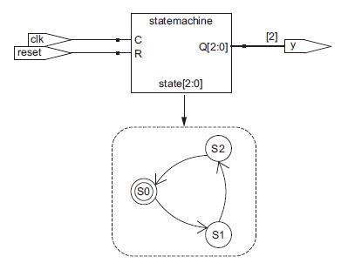
FSM: Divide by 3 counter
module divideby3FSM(input logic clk, input logic reset, output logic y);
logic [1:0] state, nextstate;
// State Register
always_ff @(posedge clk)
if (reset) state <= 2'b00;
else state <= nextstate;
// Next State Logic
always_comb
case (state)
2'b00: nextstate = 2'b01;
2'b01: nextstate = 2'b10;
2'b10: nextstate = 2'b00;
default: nextstate = 2'b00;
endcase
// Output Logic
assign y = (state == 2'b00);
endmodule

Slide 38
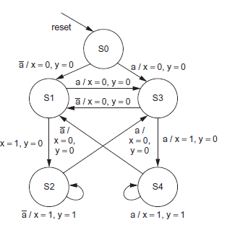
FSM: Mealy
Example below describes a finite state machine with an input a and two outputs. Output x is true when the input is the same now as it was last cycle. Output y is true when the input is the same now as it was for the past two
cycles. The state transition diagram indicates a Mealy machine because the output depends on the current inputs as well as the state.

Slide 39
FSM: Mealy
module historyFSM(input logic clk, input logic reset, input logic a, output logic x, y);
typedef enum logic [2:0]
{S0, S1, S2, S3, S4} statetype;
statetype state, nextstate;
// State Register
always_ff @(posedge clk)
if (reset) state <= S0;
else state <= nextstate;
// Next State Logic
always_comb
case (state)
S0: if (a) nextstate = S3;
else nextstate = S1;
S1: if (a) nextstate = S3;
else nextstate = S2;
S2: if (a) nextstate = S3;
else nextstate = S2;

Slide 40
FSM: Mealy
S3: if (a) nextstate = S4;
else nextstate = S1;
S4: if (a) nextstate = S4;
else nextstate = S1;
default: nextstate = S0;
endcase
// Output Logic
assign x = ((state == S1 | state == S2) & ~a) | ((state == S3 | state == S4) & a);
assign y = (state == S2 & ~a) | (state == S4 & a);
endmodule

Slide 41
Memory
Memories such as RAMs and ROMs are straightforward to model in HDL. Unfortunately, efficient circuit implementations are so specialized and process-specific that most tools cannot synthesize memories directly. Instead, a special memory generator tool or memory library may be used, or the memory can be custom-designed.
module ram #(parameter N = 6, M = 32)
(input logic clk, input logic we, input logic [N-1:0] adr,
input logic [M-1:0] din,
output logic [M-1:0] dout);
logic [M-1:0] mem[2**N-1:0];
always @(posedge clk)
if (we) mem[adr] <= din;
assign dout = mem[adr];
endmodule
This example describe a single-ported 64-wordx32-bit synchronous RAM with separate read and write data busses. When the write enable, we, is asserted, the selected address in the RAM is written with din on the rising edge of the clock. An nay event, the RAM is read out onto dout.

Slide 42
Memory : Monoport
Memories such as RAMs and ROMs are straightforward to model in HDL. Unfortunately, efficient circuit implementations are so specialized and process-specific that most tools cannot synthesize memories directly. Instead, a special memory generator tool or memory library may be used, or the memory can be custom-designed.
module ram #(parameter N = 6, M = 32)
(input logic clk, input logic we, input logic [N-1:0] adr,
input logic [M-1:0] din,
output logic [M-1:0] dout);
logic [M-1:0] mem[2**N-1:0];
always @(posedge clk)
if (we) mem[adr] <= din;
assign dout = mem[adr];
endmodule
This example describe a single-ported 64-wordx32-bit synchronous RAM with separate read and write data busses. When the write enable, we, is asserted, the selected address in the RAM is written with din on the rising edge of the clock. In any event, the RAM is read out onto dout.

Slide 43
Memory : Bi-directional Data Bus
The example shows how to modify the RAM to have a single bidirectional data bus. This reduces the number of wires needed, but requires that tristate drivers be added to both ends of the bus. Usually point-to-point wiring is preferred over tristate busses in VLSI implementations.
module ram #(parameter N = 6, M = 32)
(input logic clk,
input logic we,
input logic [N-1:0] adr,
inout tri [M-1:0] data);
logic [M-1:0] mem[2**N-1:0];
always @(posedge clk)
if (we) mem[adr] <= data;
assign data = we ? 'z : mem[adr];
endmodule
Notice that data is declared as an inout port because it can be used both as an input and output. Also, 'z is a shorthand for filling
a bus of arbitrary length with zs.

Slide 44
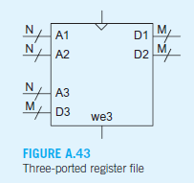
Memory : 3 Port Mmory
A multiported register file has several read and/or write ports. Example A.45 describes a synchronous register file with three ports. Ports 1 and 2 are read ports and port 3 is a write port.
module ram3port #(parameter N = 6, M = 32)
(input logic clk,
input logic we3,
input logic [N-1:0] a1, a2, a3,
output logic [M-1:0] d1, d2,
input logic [M-1:0] d3);
logic [M-1:0] mem[2**N-1:0];
always @(posedge clk)
if (we3) mem[a3] <= d3;
assign d1 = mem[a1];
assign d2 = mem[a2];
endmodule

Slide 45
Test Benches
Testbench is an HDL module used to test another module, called the device under test (DUT). The testbench contains statements to apply inputs to the DUT and, ideally, to check that the correct outputs are produced. The input and desired output patterns are called test vectors.
Consider testing a simple 3 input logic function, so we can perform exhaustive testing by applying all eight possible test vectors.
Example below demonstrates a simple testbench. It instantiates the DUT, and then applies the inputs. Blocking assignments and delays are used to apply the inputs in the appropriate order. The user must view the results of the simulation and verify by inspection that the correct outputs are produced. Testbenches are simulated just as other HDL modules. However, they are not synthesizable.

Slide 46
Test Benches
module testbench1();
logic a, b, c;
logic y;
// instantiate device under test
sillyfunction dut(a, b, c, y);
// apply inputs one at a time
initial begin
a = 0; b = 0; c = 0; #10;
c = 1; #10;
b = 1; c = 0; #10;
c = 1; #10;
a = 1; b = 0; c = 0; #10;
c = 1; #10;
b = 1; c = 0; #10;
c = 1; #10;
end
endmodule
The initial statement executes the statements in its body at the start of simulation. In this case, it first applies the input pattern 000 and waits for 10 time units. It then applies 001 and waits 10 more units, and so forth until all eight possible inputs have been applied.
Initial statements should only be used in testbenches for simulation, not in modules intended to be synthesized into actual hardware.

Slide 47
Self-checking Test Benche
module testbench2();
logic a, b, c;
logic y;
// instantiate device under test
sillyfunction dut(a, b, c, y);
// apply inputs one at a time
// checking results
initial begin
a = 0; b = 0; c = 0; #10;
assert (y === 1) else $error("000 failed.");
c = 1; #10;
assert (y === 0) else $error("001 failed.");
b = 1; c = 0; #10;
assert (y === 0) else $error("010 failed.");
c = 1; #10;
assert (y === 0) else $error("011 failed.");
a = 1; b = 0; c = 0; #10;
assert (y === 1) else $error("100 failed.");
c = 1; #10;
assert (y === 1) else $error("101 failed.");
b = 1; c = 0; #10;
assert (y === 0) else $error("110 failed.");
c = 1; #10;
assert (y === 0) else $error("111 failed.");
end
endmodule
The SystemVerilog assert statement checks if a specified condition
is true. If it is not, it executes the else statement. The $error system task in the else statement prints an error message describing the assertion failure. Assert is ignored during synthesis.

Slide 48
Testbench with Test Vector File
module testbench3();
logic clk, reset;
logic a, b, c, yexpected;
logic y;
logic [31:0] vectornum, errors;
logic [3:0] testvectors[10000:0];
// instantiate device under test
sillyfunction dut(a, b, c, y);
// generate clock
always
begin
clk = 1; #5; clk = 0; #5;
end
// at start of test, load vectors
// and pulse reset
initial
begin
$readmemb("example.tv", testvectors);
vectornum = 0; errors = 0;
reset = 1; #27; reset = 0;
end
// apply test vectors on rising edge of clk
always @(posedge clk)
begin
#1; {a, b, c, yexpected} =
testvectors[vectornum];
end
$readmemb reads a file of binary numbers into an array.

Slide 49
Testbench with Test Vector File
// check results on falling edge of clk
always @(negedge clk)
if (~reset) begin // skip during reset
if (y !== yexpected) begin
$display("Error: inputs = %b", {a, b, c});
$display(" outputs = %b (%b expected)", y, yexpected);
errors = errors + 1;
end
vectornum = vectornum + 1;
if (testvectors[vectornum] === 'bx) begin
$display("%d tests completed with %d errors", vectornum, errors);
$finish;
end
end
endmodule

Slide 50
OOP Terminology
Class - a basic building block containing routines and variables.
Object - an instance of a class.
Handle - a pointer to an object.
Property - a variable that holds data.
Method - the procedural code that manipulates variables, contained in tasks and functions.
Prototype - the header of a routine that shows the name, type, and argument list. The body of the routine contains the executable code.

Slide 51
Class
A class encapsulates the data together with the routines that manipulate it.
class transaction;
bit [31:0] addr, out, data[8];
function void display;
$display("Transaction: %h", addr);
endfunction : display
endclass : transaction

Slide 52
Class
Class handle : tr is a handle that points to an object of type Transaction. When you declare the handle tr. it is initialized to the special value null.
transaction tr; II Declare a handle
Class constructor : Next, you call the new () function to construct the Transaction object. new allocates space for the transaction, initializes the variables to their default value and returns the address where the object is stored.
tr = new(); II Allocate a Transaction object

Slide 53
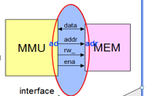
Interface
module mmu(data,addr,rw_,en);
output [15:0] addr;
output rw_,en;
inout [7:0] data;
……………..
endmodule
module mem(data,addr,rw_,en);
input [15:0] addr;
input rw_,en;
inout [7:0] data;
……………..
endmodule
module system;
wire [7:0] data;
wire [15:0] addr;
wire en,rw_;
mmu U1 (data,addr,rw_,en);
mem U2 (data,addr,rw_,en);
endmodule
Interface interf;
logic [15:0] addr;
logic [7:0] data;
logic rw_,en;
endinterface
module mmu (interf io);
……
endmodule
module mem (interf io);
……….
endmodule
module system;
interf I1;
mmu U1(I1);
mem U2(I2);
endmodule

Slide 54
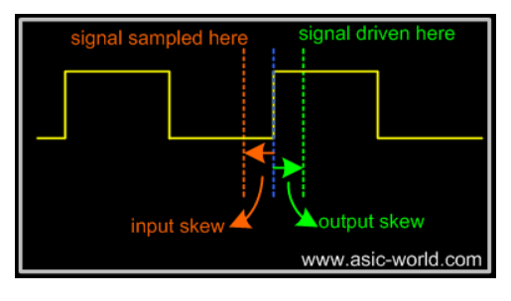
Interface
Clocking Block : An interface block uses a clocking block to specify the timing of synchronous signals relative to the clocks. Any signal in a clocking block is now driven or sampled synchronously, ensuring that your testbench interacts with the signals at the right time.

Slide 55
Modport
Modport is short for module port. They allow for the definition of different views of the signals within the interface. In many cases, just two modports, or views, are needed - One for the source-side of the interface, and one for the sink-side.
interface simple_if ();
wire we;
wire wdata;
wire full;
// source-side view
modport src (
output we,
output wdata,
input full
);
// sink-side view
modport snk (
input we,
input wdata,
output full
);
endinterface
module top();
// first, instantiate the interface
simple_if simple_if ();
// source-side module instantiation
src_side_module u_src_side_module (
.clk (clk),
.rstl (rstl),
.if(simple_if.src) // .src specifies the modport
);
// sink-side module instantiation
snk_side_module u_snk_side_module (
.clk (clk),
.rstl (rstl),
.if(simple_if.snk) // .snk specifies the modport
);
endmodule

Slide 56
Threads
In real hardware, the sequential logic is activated on clock edges, whereas combinational logic is constantly changing when any inputs change. All this parallel activity is simulated in Verilog RTL using initial and always blocks, plus the occasional gate and continuous assignment statement. To stimulate and check these blocks, your testbench uses many threads of execution, all running in parallel.
Classic Verilog has two ways of grouping statements - with begin ... end or fork ... join. Statements in a begin ... end run sequentially, whereas those in a fork ... join execute in parallel.
SV introduces two new ways to create threads - with the fork ... join_none and fork ... join_any statements.

Slide 57
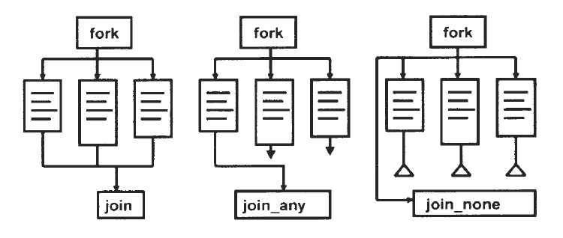
Threads
You have many verification components in a testbench and they are all required to run various tasks concurrently. They are all spawned off as separate threads via fork ... join. For example, a checker can spawn different tasks in parallel to capture and validate data originating from different parts of the testbench.

Slide 58
Mailbox
Perhaps one class needs to create many transactions and pass them to another class. How do you pass information between two threads?
The solution is a SystemVerilog mailbox. From a hardware point of view, the easiest way to think about a mailbox is that it is just a FIFO, with a source and sink. The source puts data into the mailbox and the sink gets values from the mailbox.
A mailbox is an object and thus has to be instantiated by calling the new function.
You put data into a mailbox with the put task and remove it with the get task. A put can block if the mailbox is full and a get blocks if it is empty. The peek task gets a copy of the data in the mailbox but does not remove it.

Slide 59
Randomization
class Packet;
rand bit [31:0] src, dst, data[8];
randc bit [7:0] kind;
constraint c {src > 10; src < 15; }
endclass
Packet p;
initial begin
p = new();
if (!p.randomize())
$display("Packet::randomize Successful");
else $display("Packet::randomize failed");
end

Slide 60
Event
An event is used to synchronize threads. A thread waits for an event with the @ operator. This operator is edge sensitive, and so it always blocks, waiting for the event to change. Another thread triggers the event with the -> operator, unblocking the first thread.
event e1, e2;
initial begin
$display("@%0t: 1: before trigger", $time);
-> e1; @e2;
$display(R@%0t: 1: after trigger H , $time);
end
initial begin
$display ("@%0t: 2: before trigger", $time);
-> e2; @e1;
$display ("@%0t: 2: after trigger", $time);
end
Output from blocking on an event
@0: 1: before trigger
@0: 2: before trigger
@0: 1: after trigger
event e1, e2;
initial begin
$display("@%0t: 1: before trigger", $time};
-> e1; wait (e2.triggered());
$display("@%0t: 1: after trigger", $time);
end
initial begin
$display ("@%0t: 2: before trigger", $time);
-> e2; wait (e1.triggered());
$display("@%0t: 2: after trigger", $time);
end
Output from waiting for an event
@0: 1: before trigger
@0: 2 : before trigger
@0: 1: after trigger
@0: 2 : after trigger

Slide 61
Inheritance
Parent Class : Parent
Child Class : Child
class Parent;
rand bit [31:0] src, dst, data[8];
bit [31:0] crc;
virtual function void display();
$display(“P : src=%h, dst=%h, crc=%h”, src, dst, crc);
endfunction
endclass
class Child extends Parent;
rand bit bad_crc;
virtual function void display();
$write(“C : bad_crc=%b, ", bad_crc);
super.display();
endfunction
endclass

Slide 62
Layered Testbench Structure
Testbench
Test
Environment
Scoreboard
Generator
Driver
Monitor
Interface
DUT

